Slide 1
Topic 5: Data Gathering (Part 2)
SECV2113 Human-Computer Interaction
Faculty of Computing
Universiti Teknologi Malaysia

Slide 2
Aims
Discuss how to plan and run successful data gathering sessions.
Enable you to plan and run an interview.
Enable you to design a simple questionnaire.
Enable you to plan and carry out an observation.

Slide 3
ISSUES AND CAPTURING DATA CHALLENGES
01
INTERVIEWS
02
03
QUESTIONNAIRES
OBSERVATION
04
PUTTING THE TECHNIQUES TO WORK
05

Slide 4
ISSUES AND
CAPTURING DATA CHALLENGES

Slide 5
Six Key Issues
Setting goals
Decide how to analyze data once collected
Identifying participants
Decide from whom to gather data
Determine how many participants are needed
Relationship with participants
Clear and professional
Informed consent when appropriate
Ethical considerations of collection and storage
Data collection is easy with today’s lightweight devices
Personal data is protected by regulations, consent is needed
Storage of data must be secure
Triangulation
Investigate phenomena from more than one perspective
Collect data from different sources, with different investigators, using different theoretical frameworks and different techniques
Pilot studies
Small trial of main study

Slide 6
Capturing Data
Notes, audio, video, and photographs can be used individually or in combination:
Notes plus photographs
Audio plus photographs
Video
Different challenges and advantages with each type of data recording

Slide 7
INTERVIEWS

Slide 8
Interviews
Unstructured: Not directed by a script. Rich but not replicable.
Structured: Tightly scripted, often like a questionnaire. Replicable but may lack richness.
Semi-structured: Guided by a script, but interesting issues can be explored in more depth. Can provide a good balance between richness and replicability.
Focus groups: A group interview

Slide 9
Interviews Questions
Two types:
‘Closed questions’ have a predetermined answer format, for example, ‘yes’ or ‘no’
‘Open questions’ do not have a predetermined format
Closed questions are easier to analyse
Avoid:
Long questions
Compound sentences — split them into two
Jargon and language that the interviewee may not understand
Leading questions that make assumptions, for example, why do you like …?
Unconscious biases, for instance, gender stereotypes

Slide 10
Running the Interviews
Introduction: Introduce yourself, explain the goals of the interview, reassure about the ethical issues, ask to record, and present the informed consent form.
Warm-up: Make first questions easy and non-threatening.
Main body: Present questions in a logical order
A cooling-off period: Include a few easy questions to defuse tension at the end
Closure: Thank interviewee, signal the end, for example, switch recorder off.

Slide 11
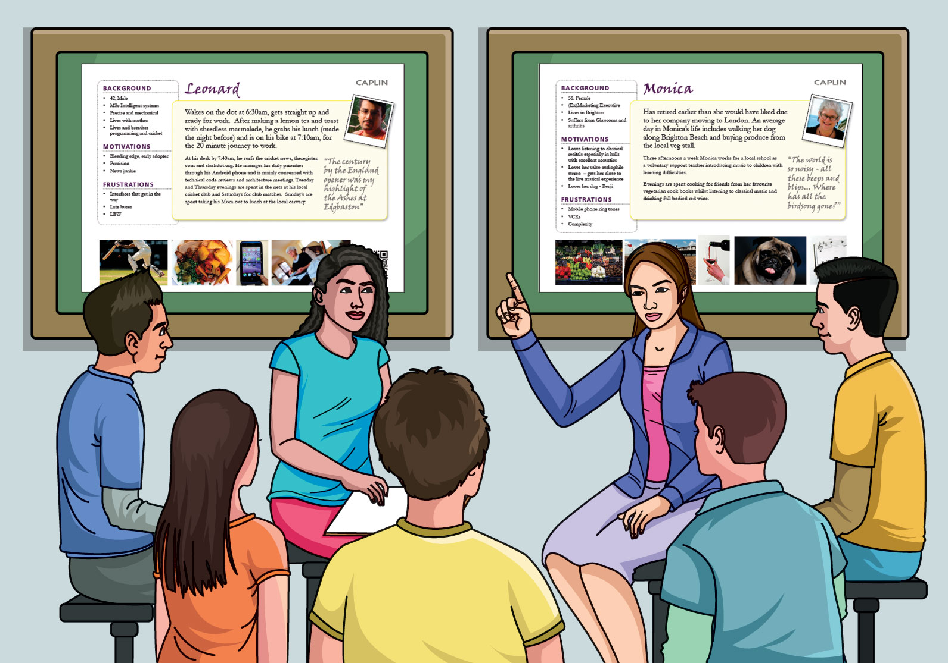
Enriching the Interview Process
Props: Devices for prompting interviewee, for example, use personas, prototypes or scenarios

Slide 12
QUESTIONNAIRES

Slide 13
Questionnaires
Questions can be closed or open
Closed questions are easier to analyze, and may be distributed and analyzed by computer
Disseminated online so can be administered to large populations
Sampling can be a problem when the size of a population is unknown as is common in online evaluations

Slide 14
Questionnaire Design
The impact of a question can be influenced by question order.
Different versions of the questionnaire may be needed for different populations.
Provide clear instructions on how to complete the questionnaire.
Consider whether the questionnaire is too long
If the questionnaire is long consider allowing participants to opt out at certain stages.
Think about layout and pacing.

Slide 15
Question and Response Format
Closed-ended responses with predefined list:
radio buttons (single response)
check boxes (multiple responses)
Rating scales
Likert scales
Semantic differential scales
3, 5, 7 or more points
Open-ended responses

Slide 16
Encouraging a Good Response
Make the purpose of study clear
Promise anonymity
Design the questionnaire carefully and run a pilot study
Offer a short version for those who do not have time to complete a long questionnaire
Follow-up with prompting messages
Provide an incentive, e.g. voucher
40% response rate is generally acceptable but much lower rates are common

Slide 17
Example Web-based Questionnaire
Questionnaire showing check boxes, radio boxes, and pull-down menus

Slide 18
Administering Questionnaires
Plan the timeline
Design offline
Program/complete online template
Test the survey to make sure that it behaves as you would expect
Test it with a group that will not be part of the survey to check that the questions are clear
Recruit participants

Slide 19
OBSERVATION

Slide 20
Observation
Direct observation in the wild
Structuring frameworks
Degree of participation (passive or participant)
Ethnography
Direct observation in controlled environments
The Think-aloud technique
Indirect observation: tracking users’ activities
Diaries
Interaction logging, web analytics and data scraping
Video and photographs collected remotely, e.g. by drones
Wearable sensors and social media

Slide 21
Structuring Frameworks to Guide Observation
Three easy-to-remember parts:
The person: Who?
The place: Where?
The thing: What?
A more detailed framework (Robson & McCarten, 2016):
Space: What is the physical space like and how is it laid out?
Actors: What are the names and relevant details of the people involved?
Activities: What are the actors doing and why?
Objects: What physical objects are present, such as furniture
Acts: What are specific individual actions?
Events: Is what you observe part of a special event?
Time: What is the sequence of events?
Goals: What are the actors trying to accomplish?
Feelings: What is the mood of the group and of individuals?

Slide 22
Planning and Conducting Observation in the Wild
Decide on how involved you will be: from passive observer to active participant
How to gain acceptance
How to handle sensitive topics, for example, culture, private spaces, and so on
How to collect the data:
What data to collect
What equipment to use
When to stop observing

Slide 23
Ethnography
Ethnography is a philosophy with a set of techniques that include participant observation and interviews
Debate about differences between participant observation and ethnography
Ethnographers immerse themselves in the culture that they study
A researcher’s degree of participation can vary
Analysing video and data logs can be time-consuming
Comments, incidents, and artifacts are collected

Slide 24
Ethnography (cont.)
Co-operation of people being observed is required
Data analysis is continuous
Interpretivist technique
Questions are refined as understanding grows
Reports usually contain examples

Slide 25
Observations and Materials that might be Collected (Crabtree, 2003)
Activity or job descriptions
Rules and procedures that govern particular activities
Descriptions of activities observed
Recordings of the talk taking place between parties
Informal interviews with participants explaining the detail of observed activities
Diagrams of the physical layout
Photographs, videos and descriptions of artifacts
Workflow diagrams showing the sequential order of tasks
Process maps showing connections between activities

Slide 26
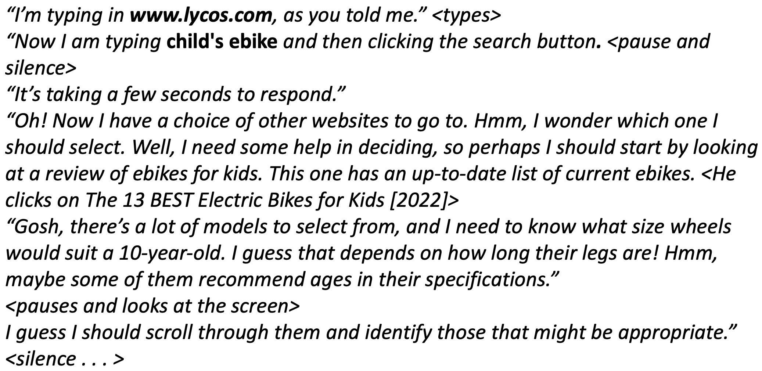
Direct Observation in a Controlled Environment
The Think-aloud Technique
Notes:
consist of observing a user working with an interface while encouraging them to "think-aloud"; to say what they are thinking and wondering at each moment.
focus on the problems a user has; when the user is working without difficulty, direct observation

Slide 27
Indirect Observation: Tracking User’s Activities
Diaries
Interaction logs
Web analytics
Data scraping
Video, audio, photos, and notes are used to capture data in both direct and indirect observation

Slide 28
PUTTING THE TECHNIQUES TO WORK

Slide 29
Choosing Techniques
Focus of the study
Participants involved
Nature of the technique(s)
Resources available
* Adapting techniques to suit different participants

Slide 30
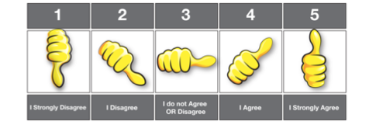
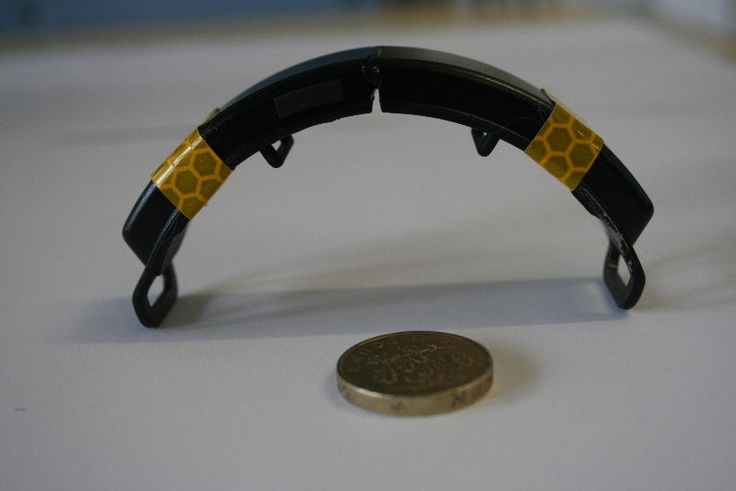
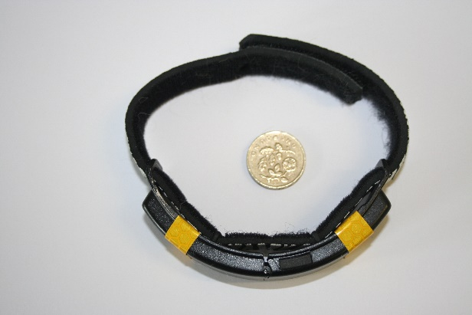
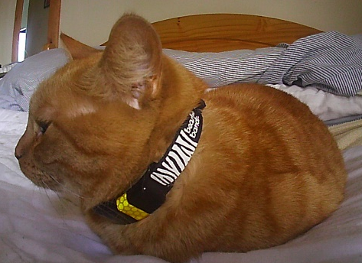
Adapting the Techniques for Different Participants
Visual representation of a Likert scale for children (Putnam et al, 2020)
GPS tracker on a cat (Paci et al, 2020)

Slide 31
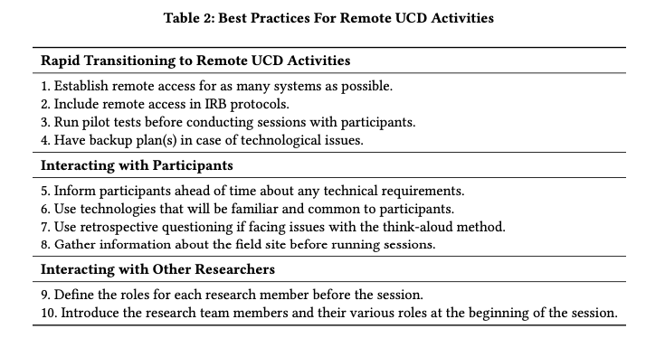
Gathering Data Remotely
Best practices for remote data gathering activities (Mastrianni et al, 2021)

Slide 32
Key Points
Data gathering sessions should have clear goals
An informed consent and other permissions may be needed
Six key issues of data gathering are: goals, identifying participants, participant relationship, ethics of collection and storage, triangulation and pilot studies
Data may be captured as notes, audio and/or video recording, photographs, or any combination of these
Interviews may be structured, semi-structured, or unstructured
Questionnaires may be on online, sent by email or paper-based
Observation may be direct or indirect; in the wild or in controlled settings
Techniques are commonly combined for any one study
Techniques may need to be adapted for participants and their context

